Slide 1



377 Operating Systems
Join on Zoom if you are remote (see Moodle for link).
Limited Direct Execution

Slide 2
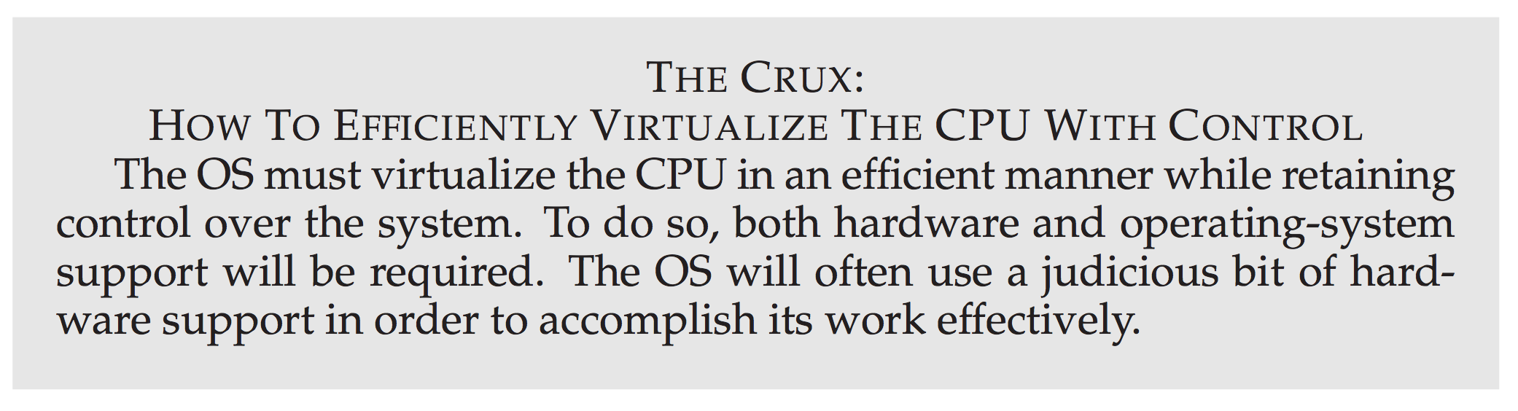

Slide 3
Basic Technique: Limited Direct Execution
To make a program run as fast as one might expect, not surprisingly OS developers came up with a technique, which we call: limited direct execution.

Slide 4
Basic Technique: Limited Direct Execution
To make a program run as fast as one might expect, not surprisingly OS developers came up with a technique, which we call: limited direct execution.
The direct execution part of the idea is simple: just run the program directly on the CPU.

Slide 5
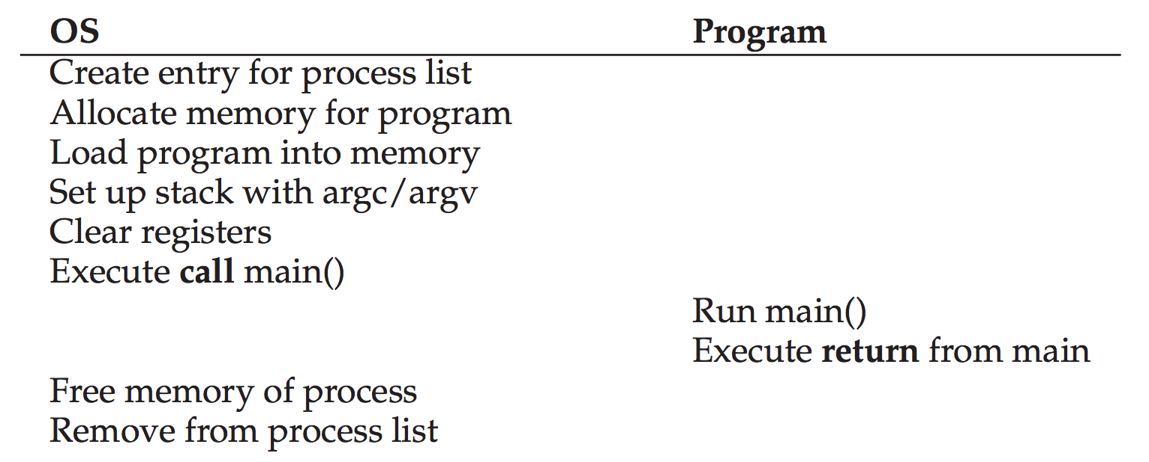
Basic Technique: Limited Direct Execution
To make a program run as fast as one might expect, not surprisingly OS developers came up with a technique, which we call: limited direct execution.
The direct execution part of the idea is simple: just run the program directly on the CPU.

Slide 6
Basic Technique: Limited Direct Execution
To make a program run as fast as one might expect, not surprisingly OS developers came up with a technique, which we call: limited direct execution.
The direct execution part of the idea is simple: just run the program directly on the CPU.

Slide 7
Basic Technique: Limited Direct Execution
To make a program run as fast as one might expect, not surprisingly OS developers came up with a technique, which we call: limited direct execution.
The direct execution part of the idea is simple: just run the program directly on the CPU.

Slide 8
Basic Technique: Limited Direct Execution
To make a program run as fast as one might expect, not surprisingly OS developers came up with a technique, which we call: limited direct execution.
The direct execution part of the idea is simple: just run the program directly on the CPU.

Slide 9
Basic Technique: Limited Direct Execution
Pretty simple…
But, there are problems…

Slide 10
Basic Technique: Limited Direct Execution
Problem #1 Restricted Operations
If we just run a program, how can the OS make sure the program doesn't do anything that we don’t want it to do, while still running it efficiently?

Slide 11
Basic Technique: Limited Direct Execution
Problem #2 Context Switching
When we are running a process, how does the operating system stop it from running and switch to another process, thus implementing the time sharing we require to virtualize the CPU?

Slide 12
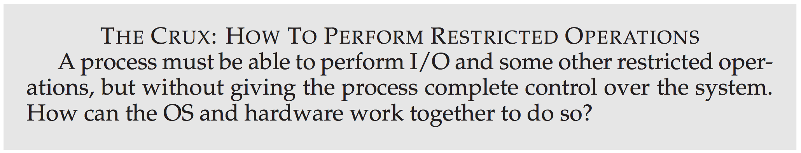
Problem #1: Restricted Operations

Slide 13
Here is a bad solution
We could let a process do whatever it wants.

Slide 14

Here is a bad solution
We could let a process do whatever it wants.
But, this is likely to be a very bad idea.
It would prevent the construction of many kinds of systems that are desirable.
For example, we can't simply let any user issue I/Os to disk.
If we did, a process could simply read or write an entire disk and thus all protections would be lost.
Notes:
Additionally the User program could corrupt the OS.

Slide 15
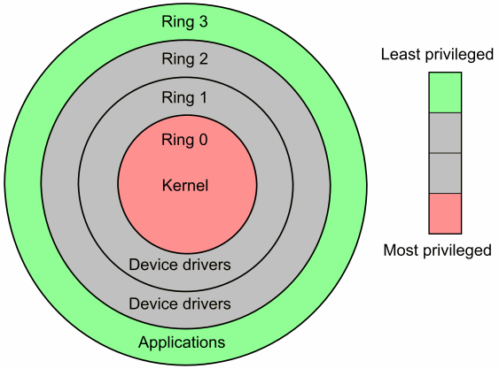

Introducing: User Mode
Thus, the approach we take is to introduce a new processor mode known as user mode.
Code that runs in user mode is restricted in what it can do.
For example, no I/O requests!
If you try, then
Notes:
Essentially if a user program attempts something that is only allowed in kernel mode (which is just some assembly instruction), then the hardware will give control to the

Slide 16

Introducing: Kernel Mode
And the other processor mode is known as kernel mode.
Code that runs in kernel mode can do whatever it wants.
For example, I/O requests!
If you try, then

Slide 17
Question?
What should a user process do when it wishes to perform some kind of privileged operation?

Slide 18
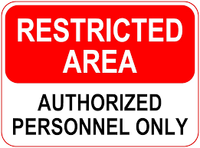
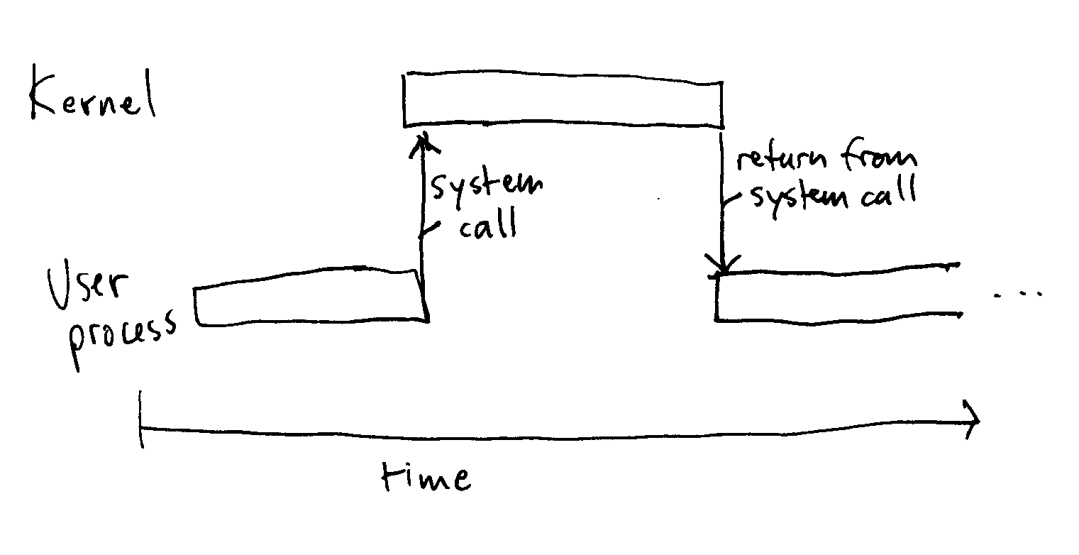
Question?
What should a user process do when it wishes to perform some kind of privileged operation?
To enable this, virtually all modern hardware provides the ability for user programs to perform a system call.

Slide 19
System Calls
System calls expose key pieces of functionality to user programs
Accessing the file system
Creating and destroying processes
Communicating with other processes
Allocating more memory
Most operating systems provide a few hundred system calls
POSIX
Early Unix systems had a more concise set of 20

Slide 20
Question?
If the kernel allows privileged functionality, how does a system call get us into the kernel?
How are system calls implemented?
We will describe this process in a “general” way.
There are a lot of specifics and differences between x86 and x86-64
Read: https://blog.packagecloud.io/eng/2016/04/05/the-definitive-guide-to-linux-system-calls/

Slide 21
Executing a System Call
To execute a system call:
A program executes a special trap instruction
Jumps into the kernel and raises the privilege level at the same time
Privileged operations can be performed

Slide 22
Executing a System Call
To execute a system call:
A program executes a special trap instruction
Jumps into the kernel and raises the privilege level at the same time
Privileged operations can be performed
When finished, the OS calls a special return-from-trap instruction
Returns to the calling program and lowers the privilege level at the same time
Privileged operations can not be performed
Notes:
SYSCALL is the trep and SYSRET is ther return on x64

Slide 23
Preparing for a System Call: Saving State
User Mode
Kernel Mode
Save state (registers)
of user process
TRAP
On the x86 this will push the program counter, flags, and a few other registers onto a per-process kernel stack.

Slide 24
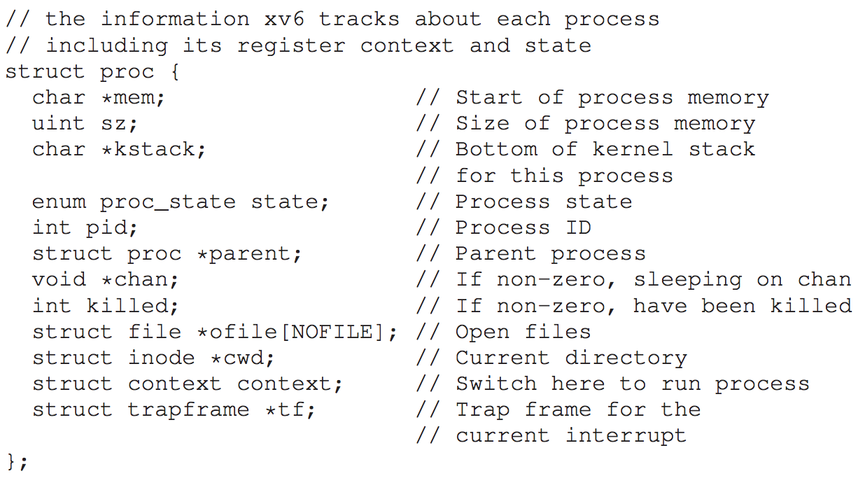
Preparing for a System Call: Saving State
User Mode
Kernel Mode
Save state (registers)
of user process
TRAP
On the x86 this will push the program counter, flags, and a few other registers onto a per-process kernel stack.
Remember this from last time?

Slide 25
Completing a System Call: Restoring State
User Mode
Kernel Mode
Restore state (registers)
of user process
RETURN-FROM-TRAP
On the x86 this will pop the program counter, flags, and a few other registers off of a per-process kernel stack.

Slide 26


How does the trap know which code to run in the OS?
Can we simply use an address?

Slide 27


At boot time...
When the machine boots up, it does so in privileged (kernel) mode, and thus is free to configure machine hardware as need be.
One of the first things the OS thus does is to tell the hardware what code to run when certain exceptional events occur (special instruction).
Code to run when a hard disk interrupt occurs
Code to run when a keyboard interrupt occurs
Code to run when a program makes a system call
TRAP TABLE

Slide 28
At boot time...
When the machine boots up, it does so in privileged (kernel) mode, and thus is free to configure machine hardware as need be.
One of the first things the OS thus does is to tell the hardware what code to run when certain exceptional events occur (special instruction).
Code to run when a hard disk interrupt occurs
Once the hardware is informed, it remembers the location of these handlers until the machine is next rebooted, and thus the hardware knows what to do (i.e., what code to jump to) when system calls and other exceptional events take place.
Code to run when a keyboard interrupt occurs
Code to run when a program makes a system call
TRAP TABLE

Slide 29
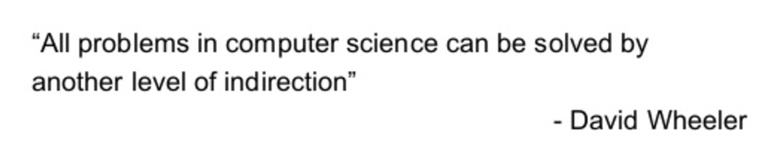
System Call Numbers
To specify the exact system call, a system call number is usually assigned to each system call.

Slide 30
System Call Numbers
To specify the exact system call, a system call number is usually assigned to each system call.
The user code is thus responsible for placing the desired system call number in a register or at a specified location on the stack.

Slide 31
System Call Numbers
To specify the exact system call, a system call number is usually assigned to each system call.
The user code is thus responsible for placing the desired system call number in a register or at a specified location on the stack.
The OS, when handling the system call inside the trap handler, examines this number, ensures it is valid, and, if it is, executes the corresponding code.

Slide 32
System Call Numbers
To specify the exact system call, a system call number is usually assigned to each system call.
The user code is thus responsible for placing the desired system call number in a register or at a specified location on the stack.
The OS, when handling the system call inside the trap handler, examines this number, ensures it is valid, and, if it is, executes the corresponding code.
This level of indirection serves as a form of protection; user code cannot specify an exact address to jump to, but rather must request a particular service via number.

Slide 33
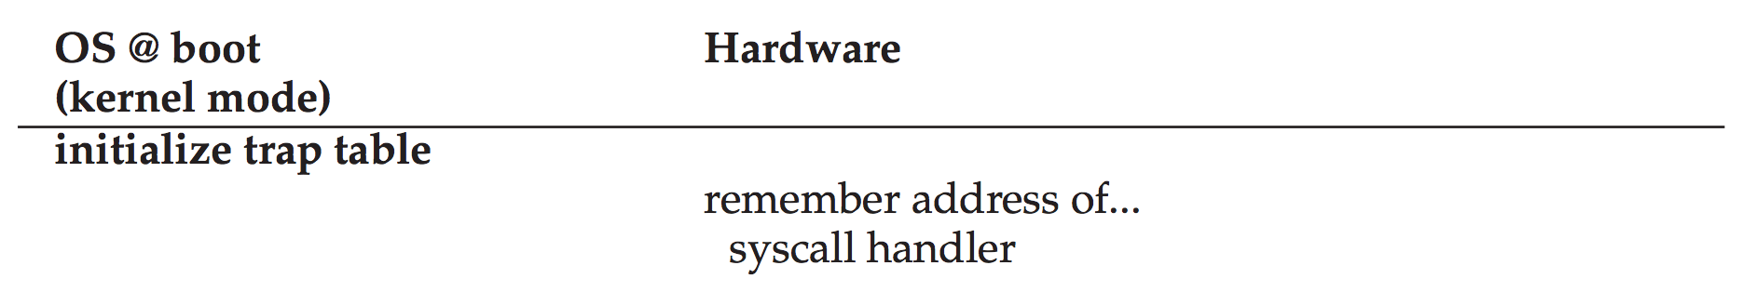
Limited Direct Execution Protocol

Slide 34
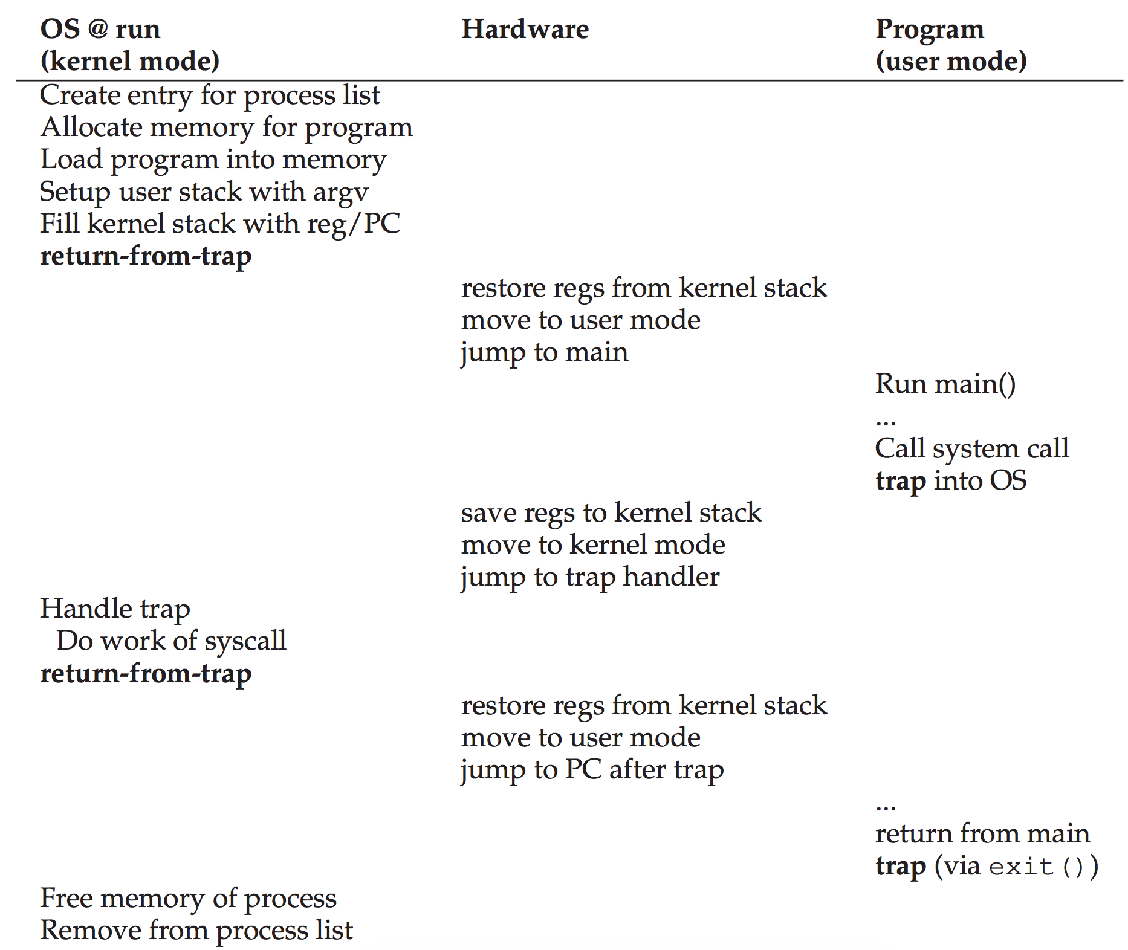
Limited Direct Execution Protocol

Slide 35
Limited Direct Execution Protocol

Slide 36
Limited Direct Execution Protocol

Slide 37
Limited Direct Execution Protocol

Slide 38
Limited Direct Execution Protocol

Slide 39
Limited Direct Execution Protocol

Slide 40
Limited Direct Execution Protocol

Slide 41
Limited Direct Execution Protocol

Slide 42
Limited Direct Execution Protocol

Slide 43
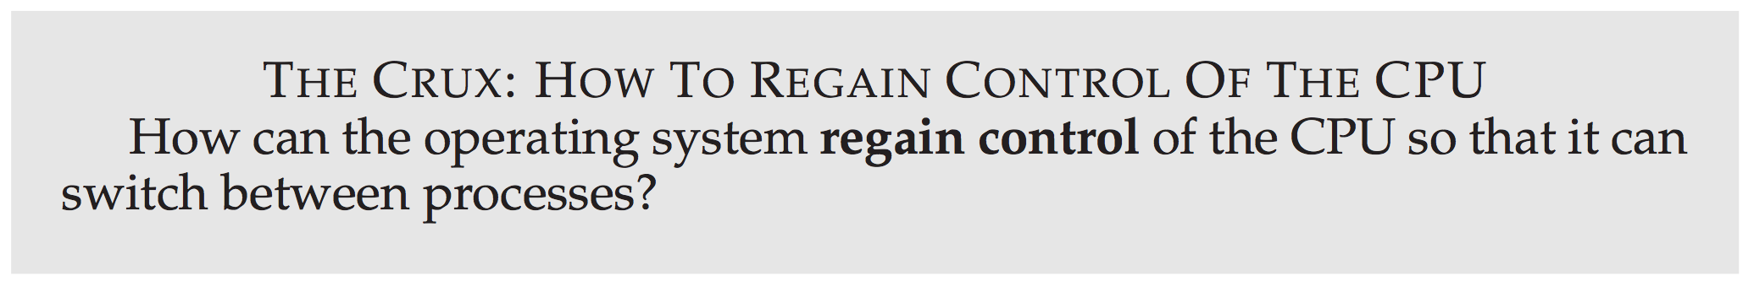
Problem #2: Switching Between Processes

Slide 44

A Cooperative Approach: Wait for System Calls
in a cooperative scheduling system, the OS regains control of the CPU by waiting for a system call or an illegal operation of some kind to take place.

Slide 45
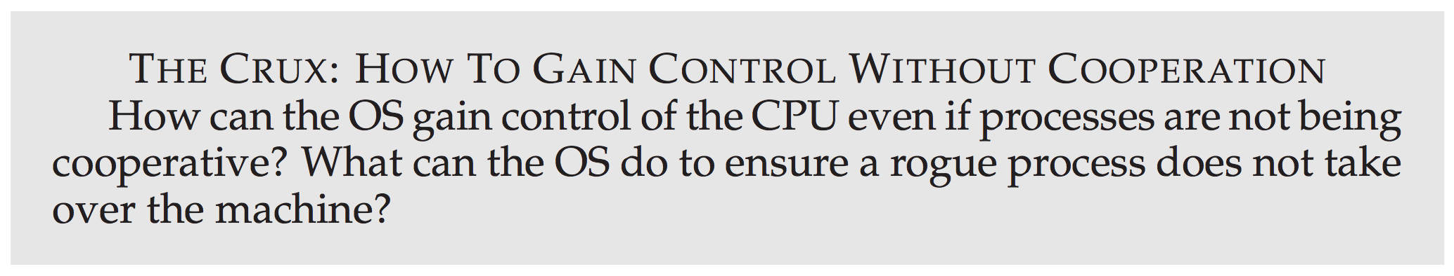

A Non-Cooperative Approach: OS Takes Control

Slide 46
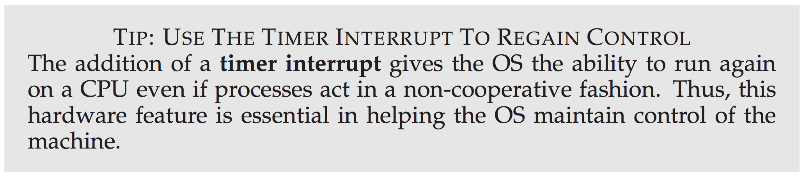
A Non-Cooperative Approach: OS Takes Control

Slide 47
Saving and Restoring Context
Now that the OS has regained control, whether cooperatively via a system call, or more forcefully via a timer interrupt, a decision has to be made:
whether to continue running the currently-running process
or switch to a different one.

Slide 48

Saving and Restoring Context
Now that the OS has regained control, whether cooperatively via a system call, or more forcefully via a timer interrupt, a decision has to be made:
whether to continue running the currently-running process
or switch to a different one.
This decision is made by a part of the operating system known as the scheduler
we will discuss scheduling policies in detail later.

Slide 49


If the decision is made to switch, the OS then executes a low-level piece of code which we refer to as a context switch.

Slide 50
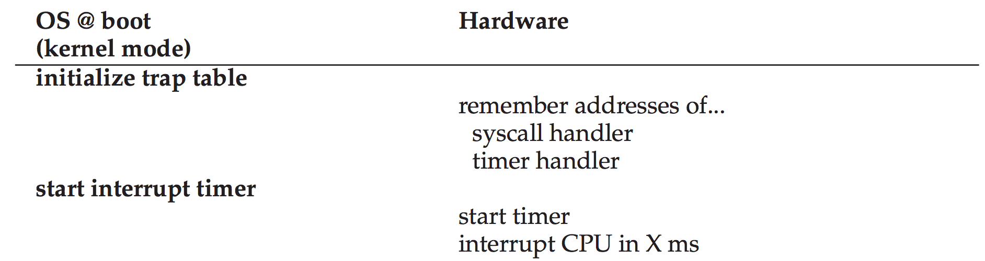
Limited Direct Execution Protocol (timer interrupt)

Slide 51
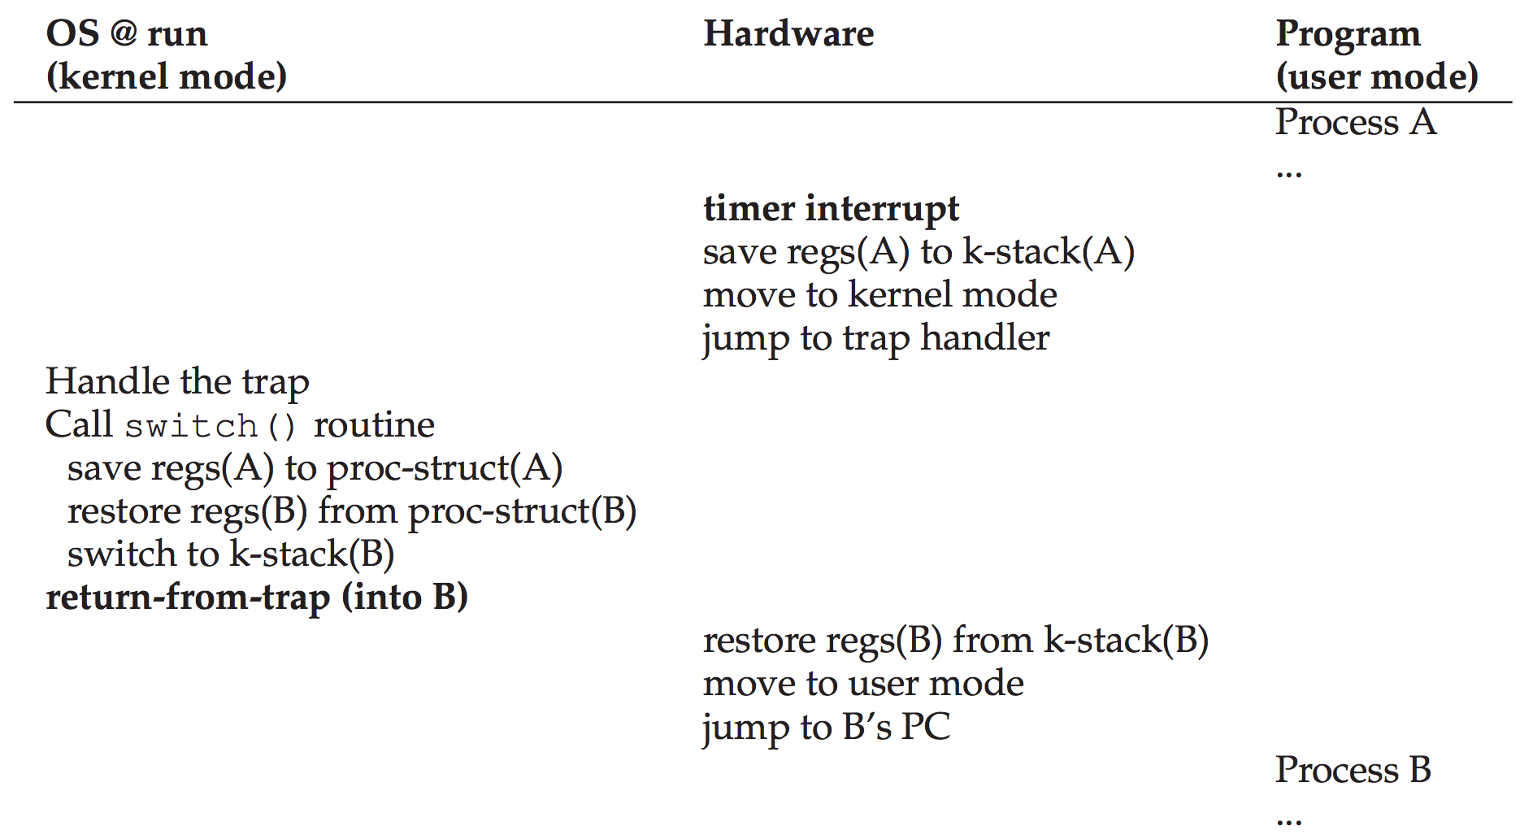
Limited Direct Execution Protocol (timer interrupt)

Slide 52
Limited Direct Execution Protocol (timer interrupt)

Slide 53
Limited Direct Execution Protocol (timer interrupt)
Notes:
Note there is a difference between the user registers saved to the kernel stack (general purpose registers etc.) and the registers saved by the OS, which are the kernel registers. There is essentially one kernel “thread” per user process. The kernel thread has an instruction pointer, and the user program does as well. Then when we switch between kernel threads, we have to save the kernel instruction pointer, then switch to another kernel thread which then may return-from-trap to its user space thread.

Slide 54
Limited Direct Execution Protocol (timer interrupt)

Slide 55
Limited Direct Execution Protocol (timer interrupt)

Slide 56

Hmm... what happens when, during a system call, a timer interrupt occurs?” or “What happens when you’re handling one interrupt and another one happens?

Slide 57
Hmm... what happens when, during a system call, a timer interrupt occurs?” or “What happens when you’re handling one interrupt and another one happens?
Disable Interrupts

Slide 58
Hmm... what happens when, during a system call, a timer interrupt occurs?” or “What happens when you’re handling one interrupt and another one happens?
Disable Interrupts
Locking schemes to protect concurrent access to OS data structures

Slide 59

The End

